Slide 1
CB- SPWM
We can generate carrier-based (CB) PWMs by comparing reference signals with triangular carrier signal.
Conventionally, it is common that one carrier signal is utilized. However, for multi-module or multi-phase inverters, multiple carrier signals can be used in order to reduce specific harmonics.

Slide 2

CB- SPWM-ACCESS
(a)
(b)
$$dv/dt$$
(c)
(d)

Slide 3
CB- SPWM-ACCESS
(a)
(b)
(c)
(d)

Slide 4










If we zoom in on a single period of the carrier signal, we observe that the transition time of PWMs for each leg do not intersect.
Therefore, we have common mode voltage at the transition times in addition to frequency of carrier signal and its triplen harmonics.
$$\frac{D_{C}T_{s }}{2}$$
CMV
$$D_{A}T_{s}$$
$$\frac{D_{C}T_{s }}{2}$$
$$\frac{{(D}_{A}−D_{C})T_{s }}{2}$$
$$D_{B}T_{s}$$
$$\frac{{(D}_{A}−D_{C})T_{s }}{2}$$
$$\frac{{(D}_{B}−D_{A})T_{s }}{2}$$
$$\frac{{(D}_{B}−D_{A})T_{s }}{2}$$
$$D_{C}T_{s}$$
$$\frac{{(1−D}_{B})T_{s }}{2}$$

Slide 5










$$D_{A}T_{s}$$
$$D_{B}T_{s}$$
$$D_{C}T_{s}$$
$$\frac{D_{C}T_{s }}{2}$$
$$\frac{D_{C}T_{s }}{2}$$
(a)
(b)
$$\frac{{(D}_{A}−D_{C})T_{s }}{2}$$
$$\frac{{(D}_{A}−D_{C})T_{s }}{2}$$
$$\frac{{(D}_{B}−D_{A})T_{s }}{2}$$
$$\frac{{(D}_{B}−D_{A})T_{s }}{2}$$
$${(1−D}_{B})T_{s }$$
(c)

Slide 6








$$D_{A}T_{s}$$
$$D_{B}T_{s}$$
$$D_{C}T_{s}$$
(a)
(b)
(c)
$$D_{A}T_{s}$$
$$D_{B}T_{s}$$
$$D_{C}T_{s}$$
$$t_{A}=0$$
$${−t}_{C}$$
$${−t}_{B}$$
(d)
(e)
(f)

Slide 7









$$t_{A}=0$$
$${−t}_{C}$$
$${−t}_{B}$$
(a)
(b)
$$D_{A}T_{s}$$
$$D_{A}T_{s}$$
$$D_{B}T_{s}$$
$$D_{B}T_{s}$$
$$D_{C}T_{s}$$
$$D_{C}T_{s}$$
(c)
(d)
(e)
(f)

Slide 8
If we use multiple carrier signal, we can reduce this common mode voltage harmonics.
However, it should be considered that in such case we increase differential harmonics as well.
While increasing switching frequency decreases the differential current harmonics since the load is inductive in differential mode, it increases common mode current harmonics since the common mode load is capacitive.
Accordingly, we can utilize an algorithm to reduce the common mode voltage harmonics, after that we can increase the switching frequency to reduce the differential mode current harmonics.
Several algorithms are utilized in the literature. However, they mostly concern the switching and its tripled harmonics.
For the switching transition, the topology should change from 2-level to multi-level ones.
The switching transition is sharper in SiC devices, which is needed to reduce the switching losses. These sharp transition, which also means that high dv/dt, can turn in higher common mode current harmonics.

Slide 9



Multiple Carrier Signals
By using multiple carrier signals, we can change the starting points of the PWMs while the duty cycles are still the same.
The aim is to intersect the switching transitions of PWMs by introducing carrier signals.
$$D_{A}T_{s}$$
Turn-off
Turn-on
$$D_{B}T_{s}$$
Turn-off
Turn-on
$$D_{C}T_{s}$$
Turn-on
Turn-off

Slide 10
(a)
(b)
(c)

Slide 11






$$D_{A}T_{s}$$
$$D_{B}T_{s}$$
$$D_{C}T_{s}$$
(a)
(b)
(c)
$$D_{A}T_{s}$$
$$D_{B}T_{s}$$
$$D_{C}T_{s}$$
(d)
(e)
(f)

Slide 12






(a)
(b)
$$D_{A}T_{s}$$
$$D_{A}T_{s}$$
$$D_{B}T_{s}$$
$$D_{B}T_{s}$$
$$D_{C}T_{s}$$
$$D_{C}T_{s}$$
(c)
(d)
(e)
(f)

Slide 13
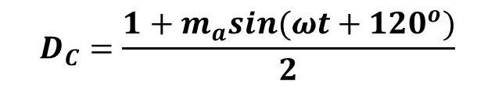

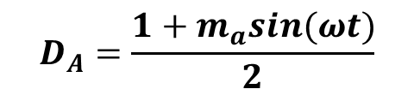






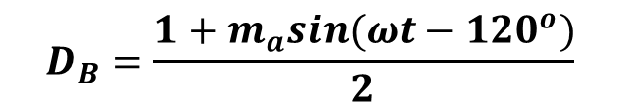
SPWM- Problem
$$D_{A}T_{s}$$
$$D_{B}T_{s}$$
$$D_{C}T_{s}$$
$$D_{A}=\frac{1+m_{a}sin(ωt)}{2}$$
$$0$$
$$Ts$$
$$\frac{3Ts}{2}$$
$$D_{B}=\frac{1+m_{a}sin(ωt−120^{o})}{2}$$
It is impossible to equate all switching states because the sum of duty cycles of SPWM is bigger than one period.
$$D_{A}+D_{B}+D_{C}=3/2$$
$$D_{C}=\frac{1+m_{a}sin(ωt+120^{o})}{2}$$

Slide 14
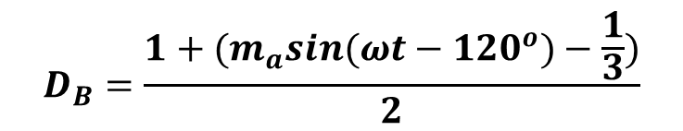
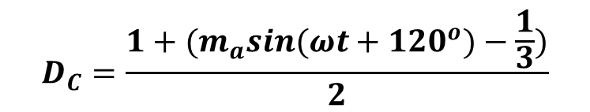
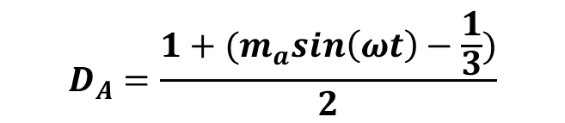
SPWM- Solution: DC Injected Reference signal
Single carrier signal
Multiple carrier signal
Multiple carrier signal with DC injected reference signal
$$D_{A}=\frac{1+{(m}_{a}sin\left(ωt\right)−\frac{1}{3})}{2}$$
$$D_{B}=\frac{1+{(m}_{a}sin(ωt−120^{o})−\frac{1}{3})}{2}$$
$$D_{C}=\frac{1+{(m}_{a}sin(ωt+120^{o})−\frac{1}{3})}{2}$$

Slide 15

(a)
(b)
(c)
(d)
(a)
(b)
(c)
(e)
(f)
(d)
(e)
(f)
$${−t}_{C}$$

Slide 16
(a)
(b)
(c)
(d)
(e)
(f)
(g)
(h)
$${−t}_{C}$$

Slide 17
(a)
(b)
$${−t}_{C}$$

Slide 18
(a)
(b)
(c)
(d)
$${−t}_{C}$$

Slide 19
Single Carrier Signal
Multi-Carrier Signals CPS- 0-120-240

Slide 20
Multi-Carrier Signals (Variable CPS- Fundamental Component Reduction)
Multi-Carrier Signals (DC injected- Variable CPS- Total Harmonic Reduction)

Slide 21
Non-Idealities

Slide 22
Drawbacks
The maximum modulation is limited to 2/3 due to DC injection.
Implementation is difficult due to delay time of practical components and other nonidealities.
Further Investigation
SVPWM or third harmonic injection to increase DC-link utilization.
Constant dv/dt for both turn-on and turn-off transition. (Variable gate resistance)
Enhanced mathematical model including dead time, different dv/dt effect (different loading).

Slide 23

Speed
SPWM
Generator
2L
VSI
EM
Controller
$$θ_{m}$$

Slide 24
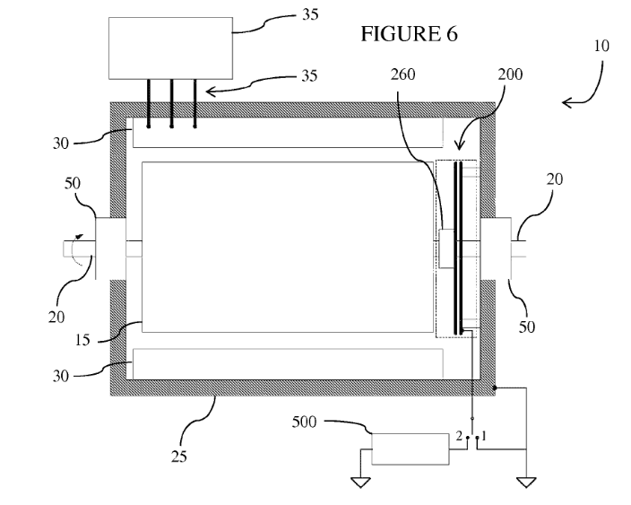
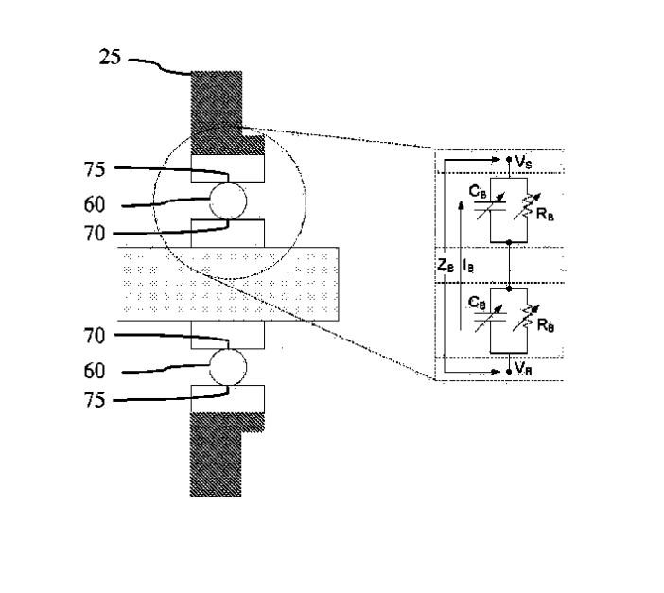
Capacitive Power Transfer
Rotary capacitor assemblies divert or mitigate high-frequency electrical currents and voltages in bearings of electric machinery (e.g., motors and generators) without direct contact with the bearings.
United States Patent, US 9,653,970B2

Slide 25
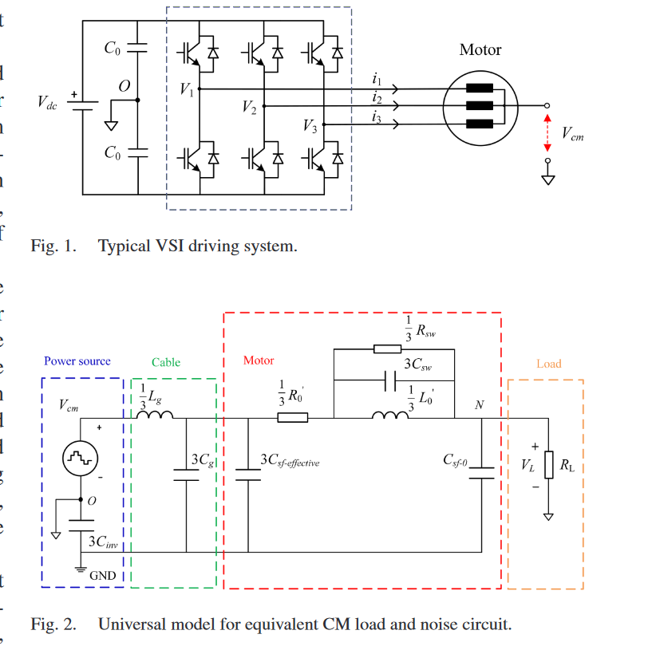
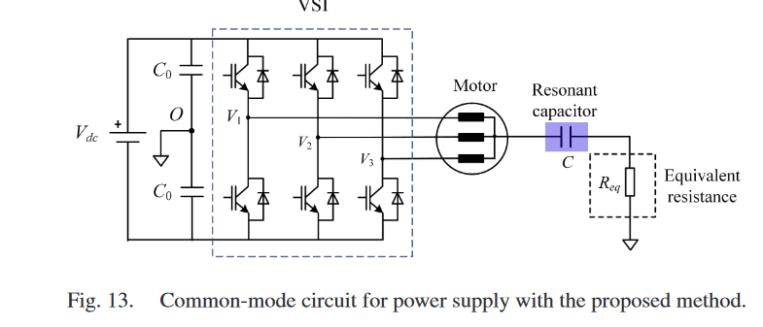
Capacitive Power Transfer
Analysis and Utilization of Common-Mode Voltage in Inverters for Power Supply, IEEE TRANSACTIONS ON POWER ELECTRONICS, VOL. 38, NO. 7, JULY 2023
From the perspective of energy utilization, this article proposed a method of powering the load by collecting the energy of CMV.

Slide 26
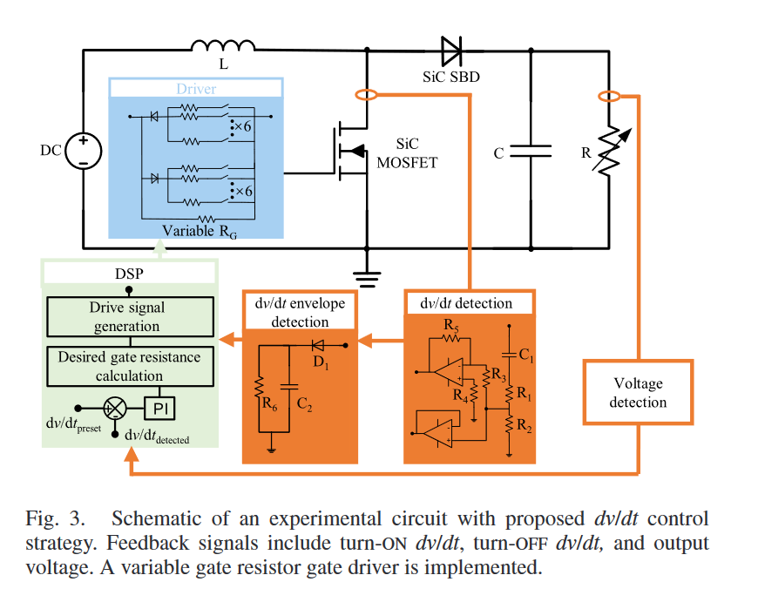
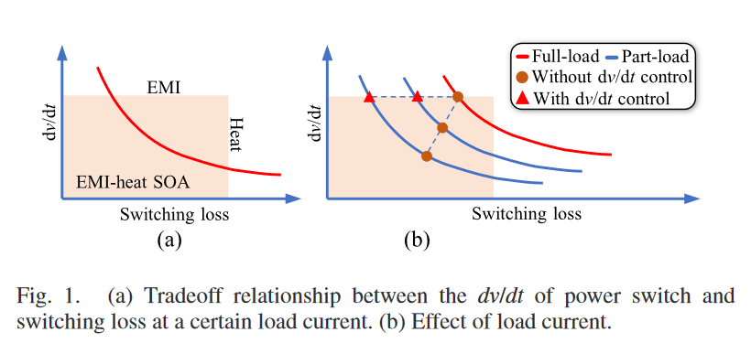
Constant dv/dt
Dynamic dv/dt Control Strategy of SiC MOSFET for Switching Loss Reduction in the Operational Power Range, IEEE TRANSACTIONS ON POWER ELECTRONICS, VOL. 37, NO. 6, JUNE 2022- LETTER

